Slide 1
Unit 7

Slide 2
Outline
Reading Summary
Definition
Formulas
Additional Resources

Slide 3
Summary
In this chapter, the concept of Random Sample is introduced.
The best way to understand the concept of random sample, think back about the relationship between the random variable and the observed value.
Remember that a random variable is a set of values that a variable can take and it is unknown. However, when the value of the variable become known or has been observed, it stops becoming a random variable and become and observed value.
The relation between the random sample and the data is similar to the relation between a random variable and the observed value.

Slide 4
Summary
The data is the observed values of a sample taken from a population. The content of the data is known.
The random sample, similarly to a random variable, is the data that will be selected when taking a sample, prior to the selection itself. The content of the random sample is unknown, since the sample has not yet been taken.
The collection of all possible evaluations of the sample is the sample space of the random sample and the probabilities of the different evaluations produce the distribution of the random sample.

Slide 5
Summary
A statistic is a function of the data. Example of statistics are the average of the data, the sample variance and standard deviation, the median of the data, etc.
The definition of a statistic can also be extended to the random sample. In other words, a statistic is also a function of a random sample
The difference between the statistic in the context of the data versus in the context of the random variable is that a statistic is known when considered in the context of the data however, the statistic is unknown (is more a random variable) in the context of a random sample.

Slide 6
Summary
From the sampling distribution of the random sample one may identify the probability of each value of the statistic, thus obtaining the sampling distribution of the statistic.
When thinking of a statistic in the context of a random sample it becomes a random variable. The distribution of the statistic is called the sampling distribution of the statistic. Consequently, we may talk of the sampling distribution of the median, the sample distribution of the sample variance, etc.
The Law of Large Numbers states that, as the sample size becomes larger, the sampling distribution of the sample average becomes more and more concentrated about the expectation.

Slide 7
Summary
The Central Limit Theorem (CLT in short) provides an approximation of this distribution.
The deviation between the sample average and the expectation of the measurement tend to decreases with the increase in sample size.
The Central Limit Theorem states that, with the increase in sample size, the sample average converges (after standardization) to the standard Normal distribution.
The conclusion of the Central Limit Theorem is that the sampling distribution of the sample average can be approximated by the Normal distribution, regardless what is the distribution of the original measurement, but provided that the sample size is large enough.

Slide 8
Summary
This statement is very important, since it allows us, in the context of the sample average, to carry out probabilistic computations using the Normal distribution even if we do not know the actual distribution of the measurement. All we need to know for the computation are the expectation of the measurement, its variance (or standard deviation) and the sample size.

Slide 9
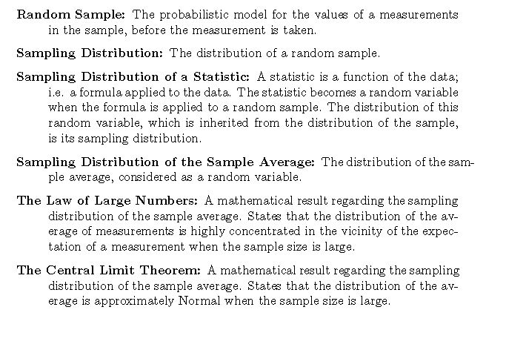
Definition

Slide 10

Formulas

Slide 11
Additional Resources
https://www.khanacademy.org/math/statistics-probability/sampling-distributions-library/what-is-a-sampling-distribution/v/introduction-to-sampling-distributions (Introduction to sampling distributions)
https://www.khanacademy.org/math/statistics-probability/sampling-distributions-library/sample-means/v/statistics-sample-vs-population-mean (Inferring population mean from sample mean + videos on central limit theorem)

